Slide 1


Jelger Oud
20/12/2024

Slide 2

Outline
Executive Summary
Introduction
Methodology
Results
Conclusion
Appendix

Slide 3
Executive Summary
In today's highly competitive aerospace industry:
SpaceX has transformed satellite launches with its innovative approach to reusable rockets, specifically the Falcon 9 and Falcon Heavy.
Key benefit: This approach dramatically lowers the cost per kilogram of payload.
Challenges: Despite its cost advantages, reliability concerns persist when compared to traditional launch systems like Soyuz and Ariane 5.
Competitive edge: To sustain its low-cost advantage over conventional launch vehicles, the success of a Falcon 9 mission is primarily defined by the ability to recover or land the booster safely.
Booster recovery success: Several factors influence the likelihood of successful booster recovery, including:
Orbital parameters
Payload weight
Booster configurations
Launch site locations
Leveraging these parameters, the supervised machine learning classification model developed in this study achieved an accuracy rate of nearly 94% in predicting booster recovery outcomes.

Slide 4
Introduction
Project Background and Context
SpaceX promotes its Falcon 9 rocket launches at a cost of $62 million per launch, while competing providers charge upwards of $165 million. The significant cost reduction is largely attributed to SpaceX's ability to reuse the first-stage booster of its rockets.
If we can accurately predict whether the first stage of the Falcon 9 rocket will successfully land, we can estimate launch costs more effectively. Such insights would be valuable for competitors looking to bid against SpaceX in the commercial launch market.
Project Objective
In this capstone project, we aim to develop a predictive model using machine learning techniques to forecast the successful landing of the Falcon 9 first stage based on historical launch data provided on SpaceX’s website.

Slide 5

Section 1

Slide 6
Methodology
Executive Summary
Data collection methodology:
Describe how data was collected
Perform data wrangling
Describe how data was processed
Perform exploratory data analysis (EDA) using visualization and SQL
Perform interactive visual analytics using Folium and Plotly Dash
Perform predictive analysis using classification models
How to build, tune, evaluate classification models

Slide 7
Data Collection
Describe how data sets were collected.
You need to present your data collection process use key phrases and flowcharts

Slide 8
Data Collection – SpaceX API
Data Source The data used in this project was collected through the SpaceX REST API by making GET requests to retrieve historical launch records.
Steps Taken:
A GET request was sent to the SpaceX API endpoint to access launch data.
The response content was received in JSON format.
The JSON data was parsed and decoded into a structured format.
The data was then converted into a Pandas DataFrame for further analysis and preprocessing.
Code Repository The complete code for the SpaceX API calls notebook can be accessed on GitHub: 👉 [Insert GitHub URL here]
Place your flowchart of SpaceX API calls here

Slide 9
Data Collection - Scraping
Data Source To complement the data obtained from the SpaceX API, additional Falcon 9 historical launch records were gathered through web scraping from a Wikipedia page.
Steps Taken:
Utilized the Beautiful Soup library along with the requests module to fetch the webpage content.
Extracted the HTML table containing Falcon 9 launch data.
Parsed the HTML table into a structured format.
Created a Pandas DataFrame to store and process the extracted data.
Code Repository The complete code for the web scraping notebook is available on GitHub: 👉[GitHub]
Place your flowchart of web scraping here

Slide 10
Data Wrangling
1. Filtering Falcon 9 Launches
The Booster Version column was used to filter the data, ensuring only Falcon 9 launches were retained in the dataset.
This step helped remove irrelevant records and focus solely on Falcon 9 missions.
2. Handling Missing Values
Payload Mass column had missing values.
These were replaced by the mean value of the column to maintain consistency and prevent data loss.
GitHub Repository The complete data wrangling notebooks can be found here: 👉

Slide 11
EDA with Data Visualization
1. Exploratory Data Analysis (EDA)
Pandas and Matplotlib were used to explore and analyze relationships between variables.
Statistical summaries and visual patterns were extracted to understand data distributions.
2. Feature Engineering
Prepared and transformed data to create meaningful features for modeling.
Enhanced dataset usability by identifying key variables influencing launch success.
3. Data Visualizations
Scatter Plots:
Visualized relationships between:
Flight Number and Launch Site
Payload Mass and Launch Site
Flight Number and Orbit Type
Payload Mass and Orbit Type
Bar Charts:
Examined success rates across different orbit types.
Line Plots:
Visualized yearly trends in launch success rates.
GitHub Repository The completed EDA and data visualization notebooks can be accessed here: 👉

Slide 12
EDA Visualization Charts
E.g. Visual Charts

Slide 13
EDA with SQL
Display the names of the unique launch sites in the space mission:
%%sql
SELECT DISTINCT LAUNCH_SITE FROM SPACEXTBL;
Display 5 records where launch sites begin with the string 'CCA’:
%%sql
SELECT LAUNCH_SITE FROM SPACEXTBL WHERE LAUNCH_SITE LIKE 'CCA%' LIMIT 5;
Display the total payload mass carried by boosters launched by NASA (CRS):
%%sql
SELECT SUM(PAYLOAD_MASS__KG_) AS Total_Payload_Mass FROM SPACEXTBL WHERE CUSTOMER = 'NASA (CRS)’;
Display the average payload mass carried by booster version F9 v1.1:
%%sql
SELECT AVG(PAYLOAD_MASS__KG_) AS Average_Payload_Mass FROM SPACEXTBL WHERE BOOSTER_VERSION = 'F9 v1.1’;
List the date when the first successful landing outcome in the ground pad was achieved:
%%sql
SELECT MIN(DATE) AS First_Successful_Landing FROM SPACEXTBL WHERE LANDING_OUTCOME = 'Success (ground pad)’;
Notes:
Queries extract insights into launch site details, payload mass, and landing success timelines.
SQL functions such as SUM(), AVG(), DISTINCT, and MIN() are used for aggregations and filtering.
GitHub Repository 👉
•List the names of the boosters which have success in drone ship and have payload mass greater than 4000 but less than 6000.
%%sql
select BOOSTER_VERSION from SPACEXTBL where LANDING_OUTCOME='Success (drone ship)' and PAYLOAD_MASS__KG_ BETWEEN 4000 and 6000;
•List the total number of successful and failure mission outcomes
%%sql
select count(MISSION_OUTCOME) as mission outcomes from SPACEXTBL GROUP BY MISSION_OUTCOME;
•List the names of the booster versions which have carried the maximum payload mass. Use a subquery
%%sql
select BOOSTER_VERSION as booster version from SPACEXTBL where PAYLOAD_MASS__KG_=(select max(PAYLOAD_MASS__KG_) from SPACEXTBL);
GitHub URL of Completed EDA with SQL Notebook
👉

Slide 14
Build an Interactive Map with Folium
👉 Interactive Map with Folium - SpaceX Launch Sites
Key Features in the Notebook
Map Creation: Used Folium to generate an interactive map displaying launch sites.
Markers: Placed markers to indicate launch outcomes (success = 1, failure = 0).
Circles and Lines: Visualized distances and coverage areas around launch sites.
Marker Clusters: Grouped multiple markers for better visualization.
Mouse Hover and Popups: Displayed site details and launch outcomes on interaction.
Purpose:
External reference for peer reviews and collaboration.
Provides reproducible steps to create interactive visualizations using Folium.
Helps explore launch data geographically to analyze patterns and success rates.

Slide 15
Build a Dashboard with Plotly Dash
Launch Site Dropdown Input Component:
Allows users to select a launch site from a dropdown menu.
Filters data dynamically based on the selected site.
Success Pie Chart (Callback Function):
Displays the success rate of launches based on the selected site.
Updates dynamically when the user changes the dropdown input.
Payload Range Slider:
Interactive slider to filter launches based on payload mass.
Allows for exploration of success patterns based on payload size.
Scatter Plot for Success vs Payload:
Plots payload mass against launch outcomes.
Visualizes trends and success rates for different payload sizes.
Dynamically updates using callback functions based on slider values.
GitHub URL of Completed Plotly Dash Application
👉

Slide 16
SpaceX Launch Records Dashboard

Slide 17
Predictive Analysis (Classification)
Overview of Finding the Best Predictive Analysis Technique
1. Data Preparation:
Loaded the dataset into a Pandas DataFrame for preprocessing and analysis.
Performed Exploratory Data Analysis (EDA) to understand data distribution and relationships.
2. Defining Labels (Outcome Variable):
Created a NumPy array from the Class column, representing whether the Falcon 9 booster landed successfully (1) or failed (0).
Converted the column into a NumPy array using: Y = data['Class'].to_numpy()
3. Feature Standardization:
Used StandardScaler() from sklearn.preprocessing to normalize features (X), ensuring all features are on the same scale, improving model performance. from sklearn.preprocessing import StandardScaler scaler = StandardScaler() X = scaler.fit_transform(X)
4. Data Splitting for Training and Testing:
Split the data into training and testing sets using train_test_split() from sklearn.model_selection.
Allocated 80% of the data for training and 20% for testing, with a random state of 2 for reproducibility. from sklearn.model_selection import train_test_split X_train, X_test, Y_train, Y_test = train_test_split(X, Y, test_size=0.2, random_state=2)
5. Model Selection:
Evaluated different supervised machine learning models like Logistic Regression, K-Nearest Neighbors (KNN), Support Vector Machines (SVM), and Decision Trees.
Compared models based on accuracy scores, precision, and recall to identify the best predictive model.
Outcome
Achieved a 94% accuracy using the best classification model based on the analysis.
The results demonstrate high reliability in predicting Falcon 9 booster landing success based on key features like payload mass, launch site, and orbit type.
Let me know if you'd like more details about model comparisons or evaluation metrics! 🚀

Slide 18
Predictive Analysis (Classification)
Finding the Best Machine Learning Model
1. Model Initialization and Hyperparameter Tuning:
Created objects for each ML algorithm (SVM, Decision Trees, K-Nearest Neighbors (KNN), and Logistic Regression).
Used GridSearchCV to perform hyperparameter tuning by testing a range of parameter values for each model.
Example for SVM: from sklearn.svm import SVC from sklearn.model_selection import GridSearchCV svm = SVC() param_grid = {'C': [0.1, 1, 10], 'gamma': [0.01, 0.1, 1], 'kernel': ['rbf', 'linear']} grid_search = GridSearchCV(svm, param_grid, cv=10) grid_search.fit(X_train, Y_train)
2. Cross-Validation and Model Fitting:
Used 10-fold cross-validation (cv=10) to split the training data into multiple subsets for validation.
Fit the training data into each GridSearchCV object to find the best hyperparameters.
3. Extracting Best Parameters and Validation Scores:
After training, retrieved the best parameters and best validation accuracy for each model: print("Best Parameters:", grid_search.best_params_) print("Best Validation Score:", grid_search.best_score_)
This process was repeated for all models (SVM, KNN, Decision Trees, and Logistic Regression).
4. Final Model Evaluation on Test Data:
Evaluated the test accuracy for each model using the score() method: test_accuracy = grid_search.score(X_test, Y_test) print("Test Accuracy:", test_accuracy)
Plotted confusion matrices for each model to visualize prediction performance: from sklearn.metrics import plot_confusion_matrix plot_confusion_matrix(grid_search.best_estimator_, X_test, Y_test, cmap='Blues') plt.show()
GitHub Repository for Code Reference 👉 Model Selection with Hyperparameter Tuning
Let me know if you need more details about specific models or results! 🚀
Key Results:
SVM achieved the highest accuracy (94%) with the best hyperparameters (C=1.0, gamma=0.03, kernel='sigmoid').
The confusion matrices highlighted areas where each model misclassified the data, helping to understand performance weaknesses.
Decision Trees and KNN showed slightly lower accuracy, making SVM the preferred model for this dataset.

Slide 19
Results
The table below shows accuracy score of test data for each of the methods comparing them to show which performed best.
Techniques include SVM, Classification Trees, K Nearest Neighbors and Logistic Regression.
GitHub Repository for Predictive Analysis Lab 👉

Slide 20

Section 2

Slide 21
Flight Number vs. Launch Site

Slide 22
Payload vs. Launch Site

Slide 23
Success Rate vs. Orbit Type

Slide 24
Flight Number vs. Orbit Type

Slide 25
Payload vs. Orbit Type

Slide 26
Launch Success Yearly Trend

Slide 27
All Launch Site Names
Find the names of the unique launch sites
All launch sites are taking as a list called launch site. Using distinct we get all the unique different sites used in launching.

Slide 28
Launch Site Names Begin with 'CCA'
This is the list of launch site specifically starts with CCA with the of LIKE query and using LIMIT query to get only top 5 results.

Slide 29
Total Payload Mass
Calculate the total payload carried by boosters from NASA
Using SUM query can make the total of all payload mass from Payload_Mass_Kg _

Slide 30
Average Payload Mass by F9 v1.1
Calculate the average payload mass carried by booster version F9 v1.1
The average payloadmass can be find by using AVG on the column of payload_mass_kg

Slide 31
First Successful Ground Landing Date
Find the dates of the first successful landing outcome on ground pad
This is the .first date of a successful landing outcome by using MIN on the date column

Slide 32
Successful Drone Ship Landing with Payload between 4000 and 6000
List the names of boosters which have successfully landed on drone ship and had payload mass greater than 4000 but less than 6000
This is the list from BOOSTER Version column and applying the two conditions on them:

Slide 33
Total Number of Successful and Failure Mission Outcomes
Calculate the total number of successful and failure mission outcomes
Used the COUNT together with the GROUP BY statement to return total number of missions outcomes.

Slide 34
Boosters Carried Maximum Payload
List the names of the booster which have carried the maximum payload mass
Using a Subquerry to return and pass the Max payload and used it list all the boosters that have carried the Max payload of 15600kgs.

Slide 35
2015 Launch Records
List the failed landing_outcomes in drone ship, their booster versions, and launch site names for in year 2015
Used the subsrt in the select statement to get the month and year from the date column where substr (Date,7,4)='2015' for year and Landing_outcome was ‘Failure (drone ship) and return the records nmatching the filter

Slide 36
Rank Landing Outcomes Between 2010-06-04 and 2017-03-20
Rank the count of landing outcomes (such as Failure (drone ship) or Success (ground pad)) between the date 2010-06-04 and 2017-03-20, in descending order
Using DESC statement.

Slide 37

Section 3

Slide 38
Folium Map | 1
There are total 4 launch sites of SpaceX :
VAFB SLC 4E: Vandenberg Space Launch Complex 4 (CA)
KSC LC29A: Kennedy Space Center Merritt Island (FL)
CCAFS LC40: Cape Canaveral Launch Complex 40 (FL)
CCAF SLC40: Cape Canaveral Space Launch Complex 40(FL)

Slide 39
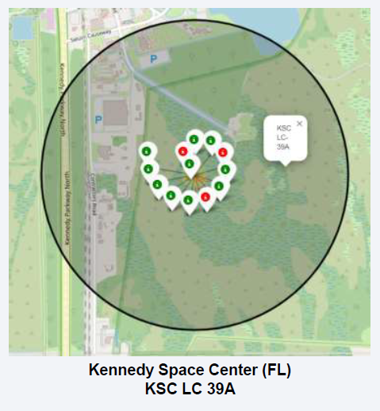
Folium Map | 2
These are the successful and unsuccessful launch sites. Green shows successful launch while red are unsuccessful launches.
The KSC LC 39A have mostly successful launches which is 10 successful while 3 unsuccessful.

Slide 40
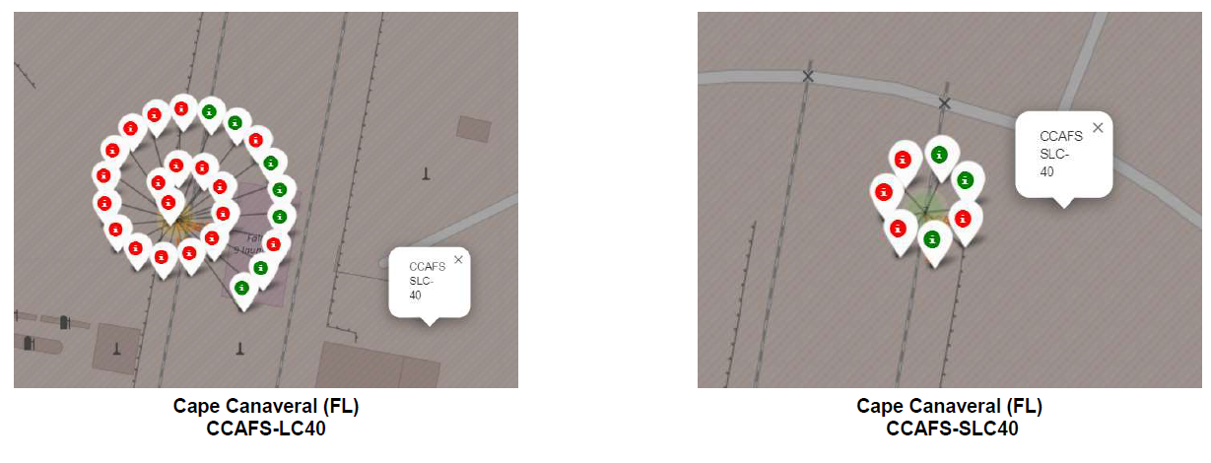
Folium Map | 3
Launch site CCAFS SLC 40 have two launch site close to each other.
The first site have 26 launches out of which only 7 were successful while the other left representation shows total 7 launches out of which only 3 were successful.
In general it is clear that the launches from this area are mostly unsuccessful.

Slide 41
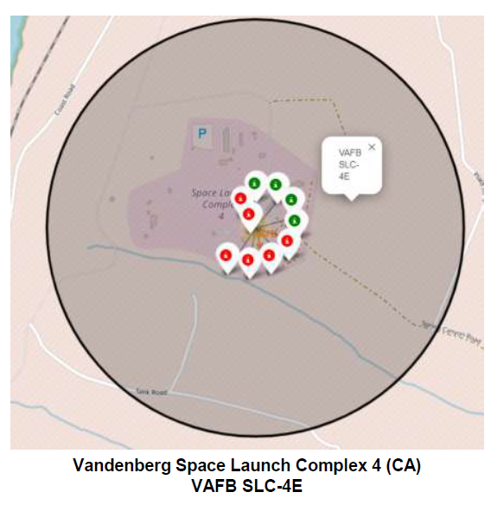
Folium Map | 4
This is the launch site close to L os Angeles which is totally opposite to other three sites.
The ratio of successful launches was not good enough having 6 unsuccessful launches with 4 successful in total of 10 launches.

Slide 42
Folium Map | 5
Launch site we use to check the distance with highways, train ways and city is Cape Canaveral (FL) CCAFS SLC 40
This map shows the line that defines the closest distance of launch site with the highway.
Distance with the highway is 0 58 km.

Slide 43
Folium Map | 6
The distance with railway line is almost 3.28 km.
Melbourne is the closest big city from the launch site which is around 51.43 km.

Slide 44

Section 4

Slide 45
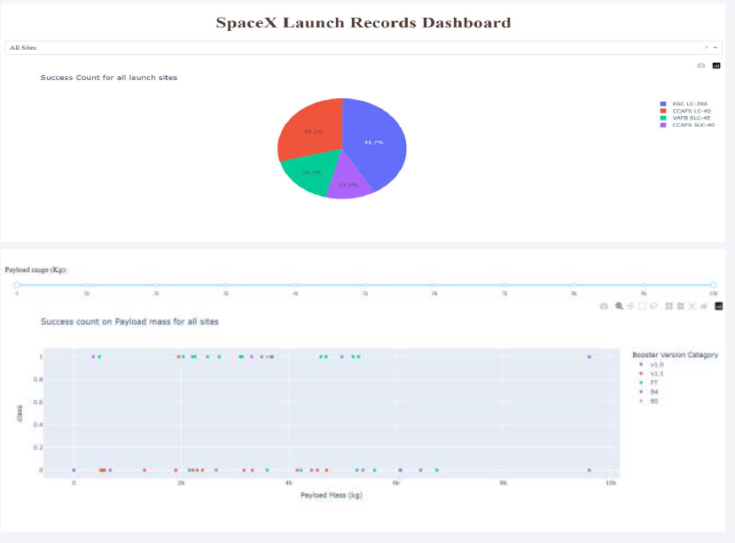
Plotly Dashboard | 1
We built an interactive dashboard with Plotly including
Dropdown menu for selecting launch sites
Pie charts displaying success rate
Scatter chart displaying launch site, payload mass, success/failure
Range slider for selecting range of payload mass in kg

Slide 46
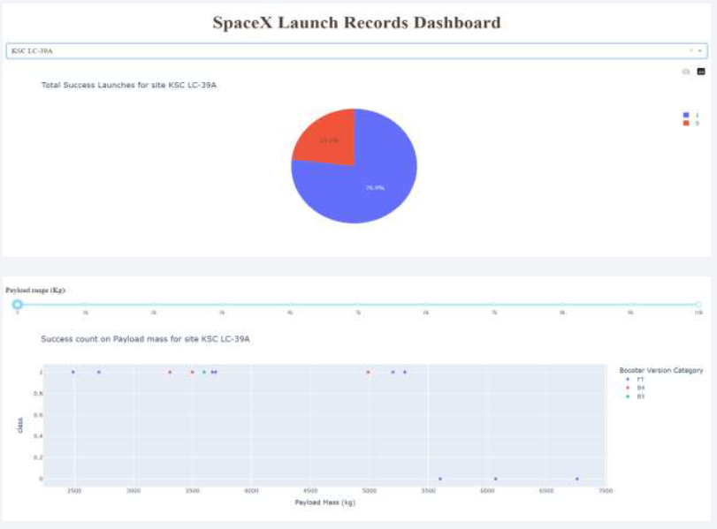
Plotly Dashboard | 2
Getting the following information by analyzing
Site with largest successful launches
Site with highest launch success rate
Payload range(s) with highest launch success rate
Payload range(s) with lowest launch success rate
F 9 Booster version (v 1 0 v 1 1 FT, B 4 B 5 etc) with highest launch success rate

Slide 47

Section 5

Slide 48
Classification Accuracy
The final results shows in two column one is of predicted method column while other is Test Data Accuracy
Total 4 predictive methods use which is Logistic Regression, SVM, Decision Tree and KNN
Decision Tree shows more accuracy which is 0.88 as compare other three which 0.83

Slide 49
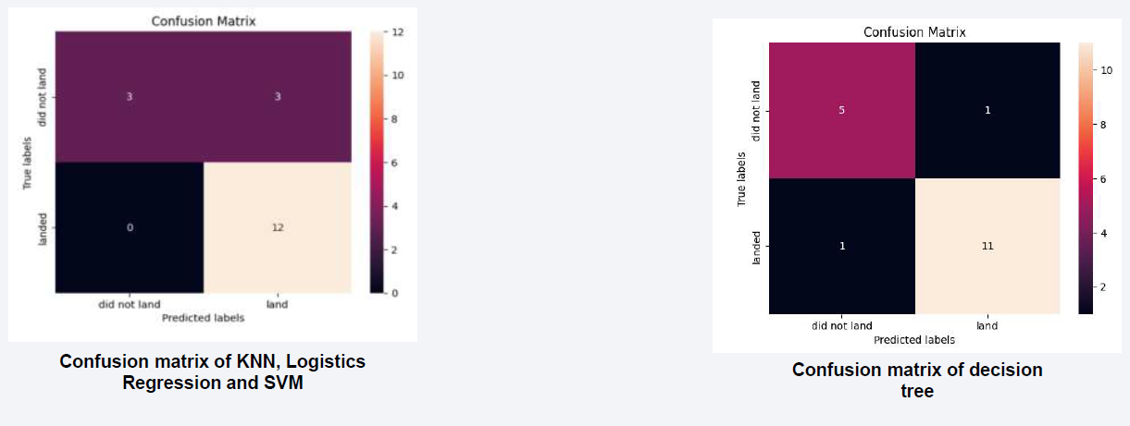
Confusion Matrix
Decision Tree is the model predicted more accuracy than other three.
Other predicted about unsuccessful landings were 100% correct while decision tree prediction about successful landing is more accurate than others.

Slide 50
Conclusions
• Different launch sites have different success rates. CCAFS LC-40, has a success rate of 60 %, while KSC LC-39A and VAFB SLC 4E has a success rate of 77%.
We can deduce that, as the flight number increases in each of the 3 launch sites, so does the success rate. For instance, the success rate for the VAFB SLC 4E launch site is 100% after the Flight number 50. Both KSC LC 39A and CCAFS SLC 40 have a 100% success rates after 80th flight
If you observe Payload Vs. Launch Site scatter point chart you will find for the VAFB-SLC launch site there are no rockets launched for heavy payload mass(greater than 10000).
Orbits ES-L1, GEO, HEO & SSO have the highest success rates at 100%, with SO orbit having the lowest success rate at ~50%. Orbit SO has 0% success rate.
LEO orbit the Success appears related to the number of flights; on the other hand, there seems to be no relationship between flight number when in GTO orbit
With heavy payloads the successful landing or positive landing rate are more for Polar, LEO and ISS. However, for GTO we cannot distinguish this well as both positive landing rate and negative landing(unsuccessful mission) are both there here
A finally the success rate since 2013 kept increasing till 2020.

Slide 51
Appendix
Include any relevant assets like Python code snippets, SQL queries, charts, Notebook outputs, or data sets that you may have created during this project

Slide 52


